Slide 1
Incessant Technologies
Robotic Automation Process Integration with Pega 7

Slide 2
Agenda
What is RPA & RDA
RDA Integration with Pega 7
Demo

Slide 3
What is RPA
Robotic Process Automation or RPA in simple words means:
“robots are going to do the tasks which are now performed by humans”.
Pega Robotic Process Automation (RPA) is a solution in which a ‘robot’ can take over standard and repetitive activities that are currently carried out by humans. RPA is not a physical machine. It is software which acts as a virtual (co-) worker in the support of processes. The robot software assists with basic tasks and as such reduces the time and cost spent on processes

Slide 4
Optimize Resources
  By automating routine tasks, your employees are free to perform more high-value work. By focusing on decision-making and customer service that need human decisions, people are more efficient and engaged.
Increase Productivity
  Gaining efficiencies though 24/7 productivity is a reality with RPA. Pega software robots can work on-demand or around the clock. This allows for faster turn-around on work requests and significantly improves SLAs.
Reduce Costs
  RPA creates an intelligent software-based workforce that lowers the cost associated with high volume, repetitive tasks that don’t require human intervention.
Reduce Risk
  When processes complete flawlessly every time, you don’t need to allocate additional time or resources to rework. Pega robots don’t make mistakes or judgment calls, and they never get tired

Slide 5
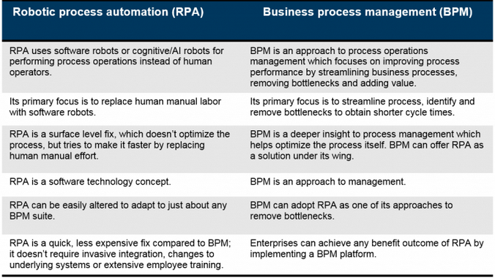

Slide 6
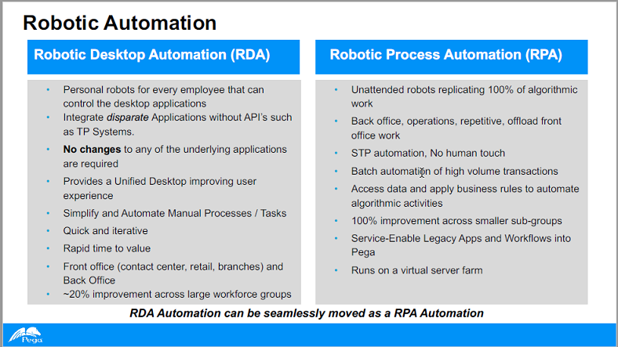

Slide 7
Pega Robotics provides two methodologies — Robotic Desktop Automation (RDA) and Robotic Process Automation (RPA) — using Microsoft Visual Studio as its development platform.
RDA deploys productivity robots to a user’s desktop, providing a unified desktop experience by increasing productivity through task automations. RDA is typically deployed for front office and back office areas in call centers, retail, and branches
RPA uses unattended robots replicating 100 percent of algorithmic work for back office, operations, and repetitive offload front office work. RPA services legacy applications and Pega workflows, and is typically deployed from a virtual server farm.

Slide 9
The Pega client invokes the automations directly through REST service running in Pega Robotic Runtime. After receiving a request, Pega Robotic Runtime starts the automation, perform the automation logic and returns an appropriate response to your pega7 application.
The Automations, with the use of Robot Activity component can invoke from any flow action that runs as part of the standard flow, modal dialog
You can invoke an automation as a pre-action or post-action, depending on the business requirement.
The Flow action must reference the automation identifier assigned to the automation within the Robot Activity

Slide 10
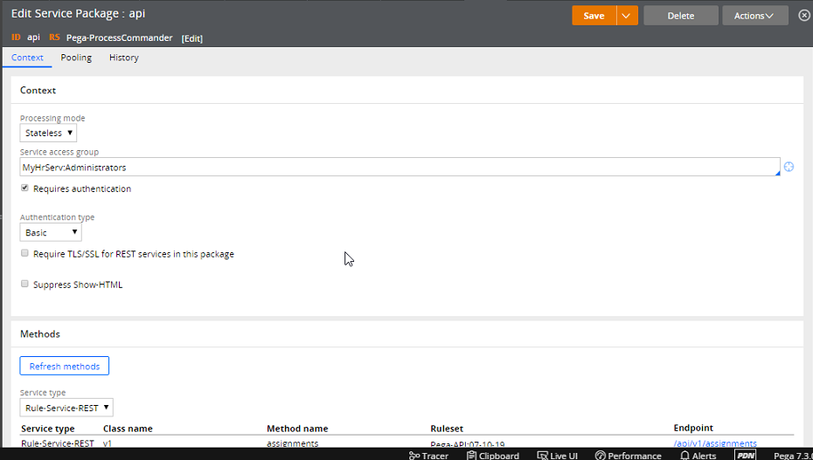
Integration with Pega 7(Service Package Settings)

Slide 11
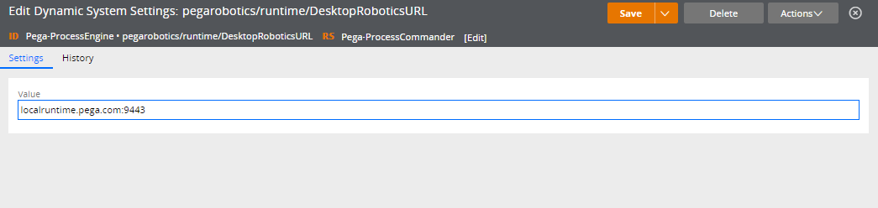
DSS for DesktopRoboticsURL

Slide 12
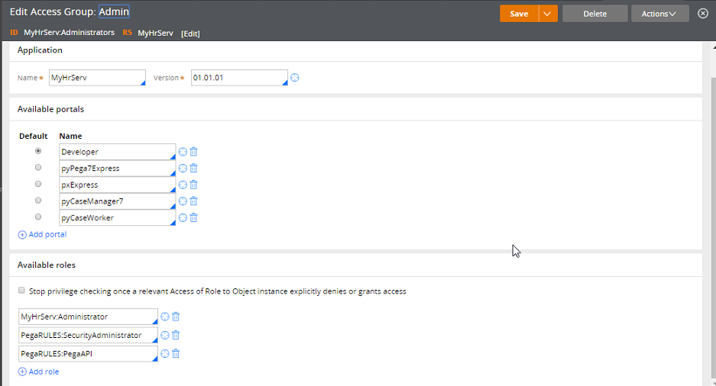
Adding the PegaAPI to Access Group

Slide 13
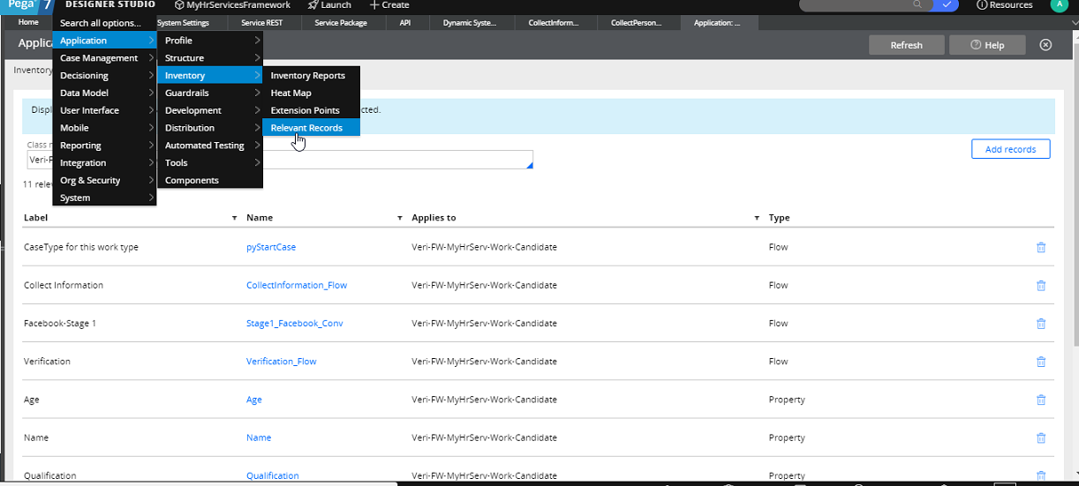
Adding the Relevant Records

Slide 14
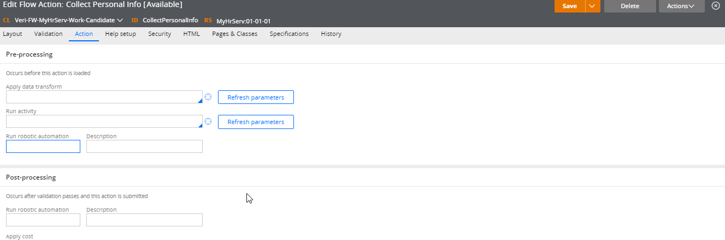
Run Robotic Automation in the flow action

Slide 15
StudioConfig.xml
<Robotics>
<PegaServer baseUrl="https://localhost:8080/prweb/api/v1/"/>
<RDA_Credentials userName="user" password="password"/>
</Robotics>

Slide 16
RuntimeConfig.xml
<Robotics>
<PegaServer baseUrl=“http://localhost:8080/prweb/PRServlet" />
<LocalApiService enabled="true" SSL="true" port="9443" allowedOrigins="*.pega.com" JWTSecurity="false" PegaServerURL=""/>
</Robotics>

